Slide 1
Number Theory
Abu Sayed Md. Mostafizur Rahaman, PhD Professor Department of Computer Science and Engineering Jahangirnagar University

Slide 2
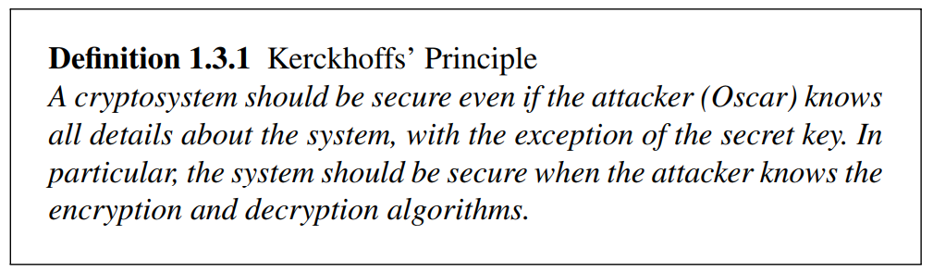
Kerckhoffs’ Principle

Slide 3
Short Introduction to Modular Arithmetic
Why do we need to study modular arithmetic?
Extremely important for asymmetric cryptography (RSA, elliptic curves etc.)
Some historical ciphers can be elegantly described with modular arithmetic (cf. Caesar and affine cipher later on).

Slide 4
Short Introduction to Modular Arithmetic
Generally speaking, most cryptosytems are based on sets of numbers that are
discrete (sets with integers are particularly useful)
finite (i.e., if we only compute with a finiely many numbers)
Seems too abstract? --- Let‘s look at a finite set with discrete numbers we are quite familiar with: a clock.
12
11
1
10
2
9
3
8
4
7
5
6
Interestingly, even though the numbers are incremented every hour we never leave the set of integers:
1, 2, 3, … 11, 12, 1, 2, 3, … 11, 12, 1, 2, 3, …:

Slide 5
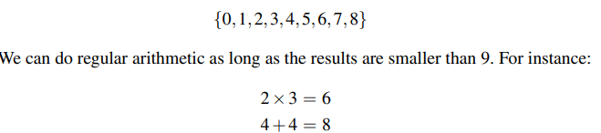
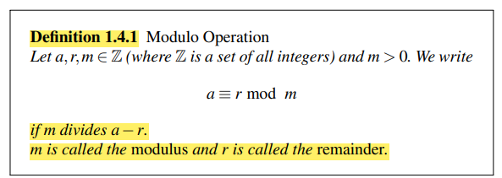
Example 1.5. We consider the set of the nine numbers
But what about 8+4? Now we try the following rule: Perform regular integer arithmetic and divide the result by 9. We then consider only the remainder rather than the original result. Since 8+4 = 12, and 12/9 has a remainder of 3, we write: 8+4 ≡ 3 mod 9
We now introduce an exact definition of the modulo operation:

Slide 6
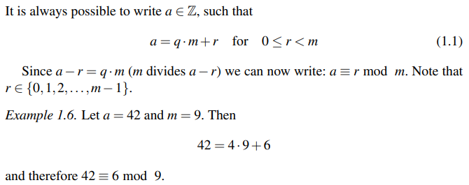
Computation of the Remainder

Slide 7
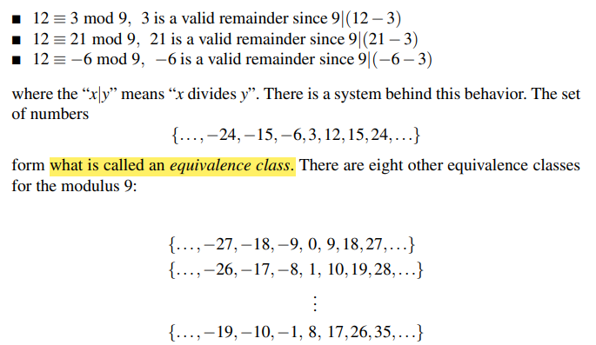
The Remainder Is Not Unique?
For every given modulus m and number a, there are (infinitely) many valid remainders
Example 1.7. We want to reduce 12 modulo 9. Here are several results which are correct according to the definition:

Slide 8
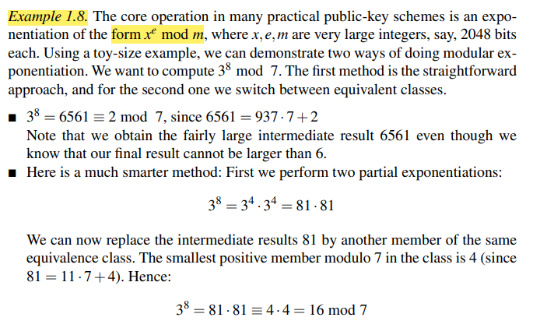
All Members of a Given Equivalence Class Behave Equivalently?
For a given modulus m, it does not matter which element from a class we choose for a given computation
From here we obtain the final result easily as 16 ≡ 2 mod 7
Notes:
Note that we could perform the second method without a pocket calculator since the numbers never become larger than 81. For the first method, on the other hand, dividing 6561 by 7 is mentally already a bit challenging. As a general rule we should remember that it is almost always of computational advantage to apply the modulo reduction as soon as we can in order to keep the numbers small

Slide 9


Which Remainder Do We Choose?
Mathematically it does not matter which member of an equivalent class we use

Slide 10
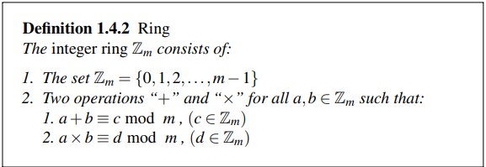
Integer Rings
Let’s look at the mathematical construction that we obtain if we consider the set of integers from zero to m−1 together with the operations addition and multiplication:

Slide 11
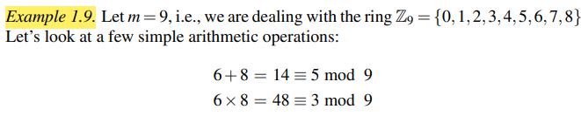

Slide 12
Properties of Modular Arithmetic (3)
How do we perform modular division?
First, note that rather than performing a division, we prefer to multiply by the inverse. Ex:
b / a≡ b x a⁻¹ mod m
The inverse a⁻¹ of a number a is defined such that:
a a⁻¹ ≡ 1 mod m
Ex: What is 5 / 7 mod 9 ?
The inverse of 7 mod 9 is 4 since 7 x 4 ≡ 28 ≡ 1 mod 9, hence:
5 / 7 ≡ 5 x 4 = 20 ≡ 2 mod 9
How is the inverse compute?
The inverse of a number a mod m only exists if and only if:
gcd (a, m) = 1
(note that in the example above gcd(5, 9) = 1, so that the inverse of 5 exists modulo 9)

Slide 13
Properties of Modular Arithmetic (4)
Modular reduction can be performed at any point during a calculation
Let’s look first at an example. We want to compute 3⁸ mod 7 (note that exponentiation is extremely important in public-key cryptography).
1. Approach: Exponentiation followed by modular reduction
3⁸ = 6561 ≡ 2 mod 7
Note that we have the intermediate result 6561 even though we know that the final result can’t be larger than 6.
2. Approach: Exponentiation with intermediate modular reduction
3⁸ = 3⁴ 3⁴ = 81 x 81
At this point we reduce the intermediate results 81 modulo 7:
3⁸ = 81 x 81 ≡ 4 x 4 mod 7
4 x 4 = 16 ≡ 2 mod 7
Note that we can perform all these multiplications without pocket calculator, whereas mentally computing 3⁸ = 6561 is a bit challenging for most of us.
General rule: For most algorithms it is advantageous to reduce intermediate results as soon as possible.

Slide 14
Algebraic View on Modulo Arithmetic: The Ring Z_{m} (1)
We can view modular arithmetic in terms of sets and operations in the set. By doing arithmetic modulo m we obtain the integer ring Z_{m} .with the following properties:
Closure: We can add and multiply any two numbers and the result is always in the ring.
Addition and multiplication are associative, i.e., for all a,b,c ε Z_{m}
a + (b + c) = (a + b) + c
a × (b × c) = (a × b) × c
and addition is commutative: a + b = b + a
The distributive law holds: a×(b+c) = (a×b)+(a×c) for all a,b,c ε Z_{m}
There is the neutral element 0 with respect to addition, i.e., for all a ε Z_{m}
a + 0 ≡ a mod m
For all a ε Z_{m}, there is always an additive inverse element –a such that
a + (-a) ≡ 0 mod m

Slide 15
Algebraic View on Modulo Arithmetic: The Ring Z_{m} (2)
There is the neutral element 1 with respect to multiplication, i.e., for all a ε Z_{m}
a × 1 ≡ a mod m
The multiplicative inverse a⁻¹
a × a⁻¹ ≡ 1 mod m
exists only for some, but not for all, elements in Z_{m}.
Roughly speaking, a ring is a structure in which we can always add, subtract and multiply, but we can only divide by certain elements (namely by those for which a multiplicative inverse exists).

Slide 16
An Algebraic View on Modulo Arithmetic: The Ring Z_{m} (2)
We recall from above that an element a ε Z_{m} has a multiplicative inverse only if:
gcd (a, m) = 1
We say that a is coprime or relatively prime to m.
Ex: We consider the ring Z₉ = {0,1,2,3,4,5,6,7,8}
The elements 0, 3, and 6 do not have inverses since they are not coprime to 9.
The inverses of the other elements 1, 2, 4, 5, 7, and 8 are:
1⁻¹ ≡ 1 mod 9 2⁻¹ ≡ 5 mod 9 4⁻¹ ≡ 7 mod 9
5⁻¹ ≡ 2 mod 9 7⁻¹ ≡ 4 mod 9 8⁻¹ ≡ 8 mod 9

Slide 17
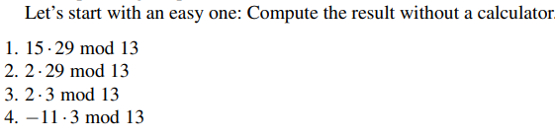

Exercises

Slide 18
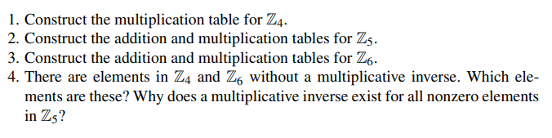
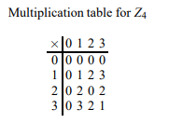
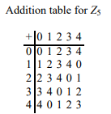
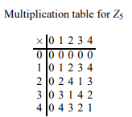
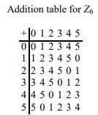
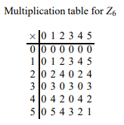

We consider the ring ℤ₄. Construct a table that describes the addition of all elements in the ring with each other

Slide 19
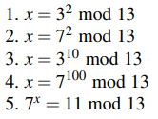
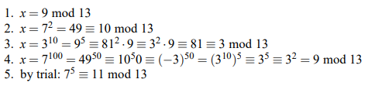
Compute x as far as possible without a calculator

Slide 20
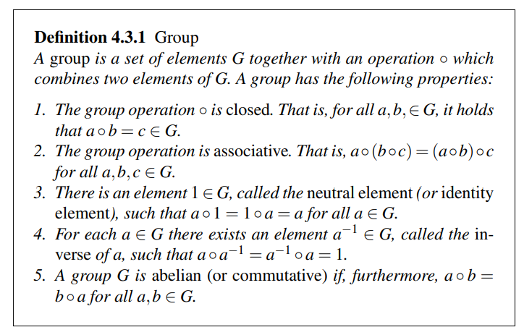
Some Mathematics: A Brief Introduction to Galois Fields
A finite field, sometimes also called Galois field, is a set with a finite number of elements. Roughly speaking, a Galois field is a finite set of elements in which we can add, subtract, multiply and invert.
Before we introduce the definition of a field, we first need the concept of a simpler algebraic structure, a group
Roughly speaking, a group is set with one operation and the corresponding inverse operation
If the operation is called addition, the inverse operation is subtraction;
if the operation is multiplication, the inverse operation is division

Slide 21
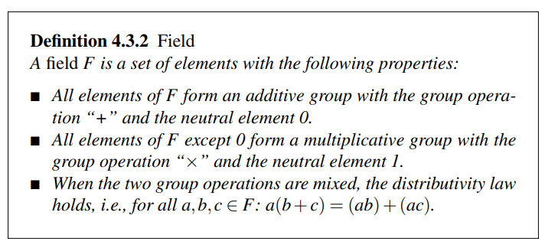
The set of integers Zₘ (also denoted as ℤₘ) consists of the elements {0, 1, …, m-1}.
The set of real numbers forms a field with the following properties:
Additive Group: The neutral element for the additive group is 0. For any real number a, there exists an additive inverse, denoted as -a such that a + (-a) ≡ 0 (mod m).
Multiplicative Group: The neutral element for the multiplicative group is 1. Every nonzero element a has a multiplicative inverse, denoted as 1/a such that a · a⁻¹ ≡ 1 (mod m).

Slide 22
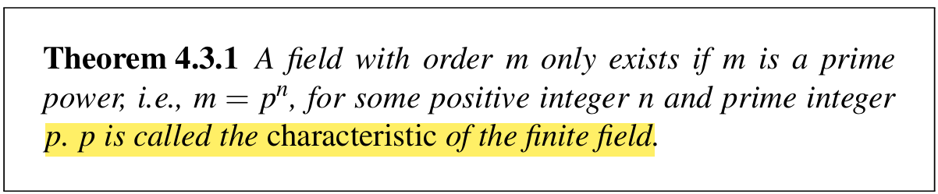
In cryptography, we are almost always interested in fields with a finite number of elements, which we call finite fields or Galois fields. The number of elements in the field is called the order or cardinality of the field. Of fundamental importance is the following theorem:

Slide 23
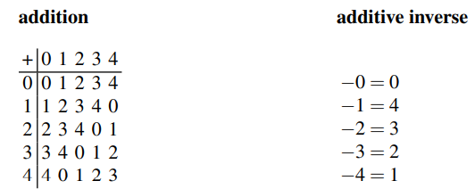
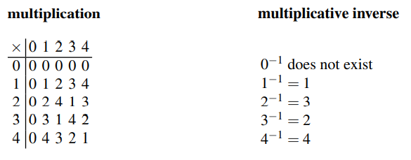
Find the multiplication inverse pairs of module 5 Solution:
$$a:1,2,3,4$$ $$x:1,2,3,4$$ | $$a∙x≡1 (mod 5)$$ |  |  | $$a^{−1} \left(mod 5\right):x$$
$$x:1,2,3,4$$ |  |  |  | $$x^{−1} \left(mod 5\right):a$$
 | $$a=1$$ | $$1∙x≡1 \left(mod 5\right);$$ | $$(1,1)$$ | $$−1=1)$$
 | $$a=2$$ | $$2∙x≡1 \left(mod 5\right);$$ | $$(2,3)$$ | $$(−2=3)$$
 | $$a=3$$ | $$3∙x≡1 \left(mod 5\right);$$ | $$(3,2)$$ | $$(−3=2)$$
 | $$a=4$$ | $$4∙x≡1 \left(mod 5\right);$$ | $$(4,4)$$ | $$(−4=4)$$

Slide 24
Euclidean Algorithm
Compute the greatest common divisor gcd (r_{0,} r₁) of two integers r₀ and r₁
gcd is easy for small numbers: 1. factor r₀ and r₁ 2. gcd = highest common factor
Example: r₀ = 84 = 2 . 2 . 3 . 7 r₁ = 30 = 2 . 3 . 5
→ The gcd is the product of all common prime factors: 2 . 3 = 6 = gcd (30,84)
But: Factoring is complicated (and often infeasible) for large numbers

Slide 25

Euclidean Algorithm Cont..
Observation: gcd (r_{0,} r₁) = gcd (r₀ - r₁, r₁)
→ Core idea:
Reduce the problem of finding the gcd of two given numbers to that of the gcd of two smaller numbers
Repeat process recursively
The final gcd (r_{i,} 0) = r_{i} is the answer to the original problem !

Slide 26
Euclidean Algorithm 2/2
Observation: gcd (r_{0,} r₁) = gcd (r₀ - r₁, r₁)
→ Core idea:
Reduce the problem of finding the gcd of two given numbers to that of the gcd of two smaller numbers
Repeat process recursively
The final gcd (r_{i,} 0) = r_{i} is the answer to the original problem !
Example: gcd (r_{0,} r₁) for r₀ = 27 and r₁ = 21
Note: very efficient method even for long numbers: The complexity grows linearly with the number of bits
For the full Euclidean Algorithm see Chapter 6 in Understanding Cryptography.
Notes:
The Euclidean algorithm is very efficient, even with the very long numbers typically used in public-key cryptography. The number of iterations is close to the number of digits of the input operands. That means, for instance, that the number of iterations of a gcd involving 1024-bit numbers is 1024 times a constant. Of course, algorithms with a few thousand iterations can easily be executed on today’s PCs, making the algorithms very efficient in practice

Slide 27
Extended Euclidean Algorithm
An extension of the algorithm allows us to compute modular inverses, which is of major importance in public-key
cryptography. In addition to computing the gcd, the extended Euclidean algorithm (EEA) computes a linear combination of the form: gcd(r₀,r₁) = s·r₀ +t ·r₁
where s and t are integer coefficients. This equation is often referred to as Diophantine equation.

Slide 28
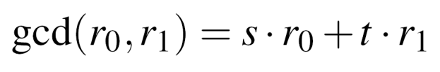
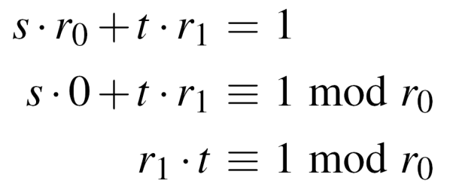
Extended Euclidean Algorithm (cont...)
Extend the Euclidean algorithm to find modular inverse of r₁ mod r₀
EEA computes s,t, and the gcd :
Take the relation mod r₀
→ Compare with the definition of modular inverse: t is the inverse of r₁ mod r₀
Note that gcd (r_{0,} r₁) = 1 in order for the inverse to exist
Recursive formulae to calculate s and t in each step
→ „magic table“ for r, s, t and a quotient q to derive the inverse with pen and paper
(cf. Section 6.3.2 in Understanding Cryptography)

Slide 29
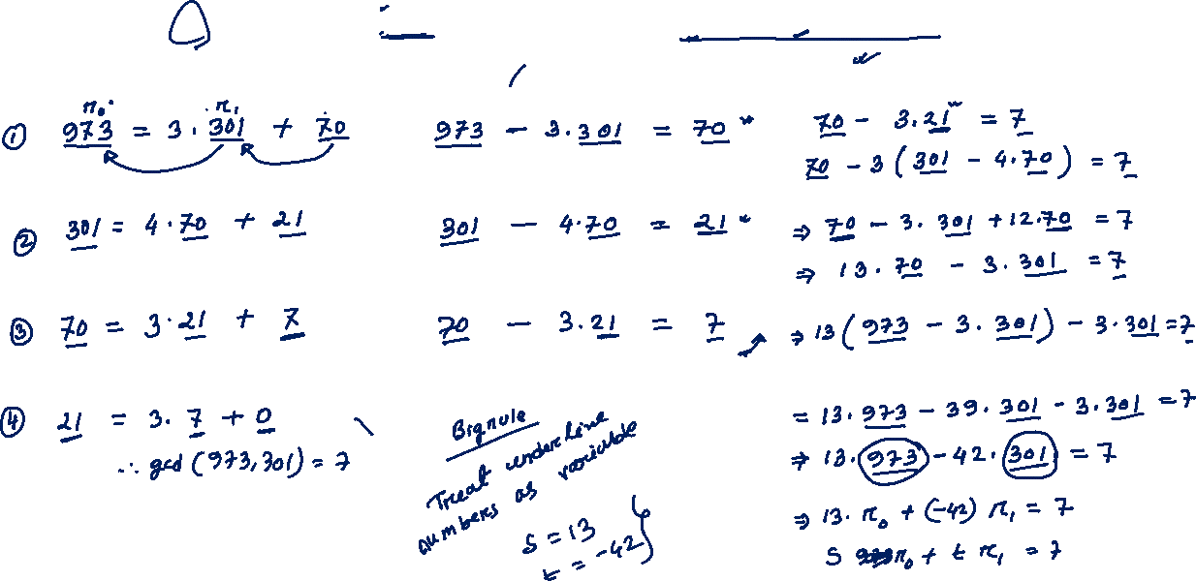
Example We consider the extended Euclidean algorithm to find the coefficient of s₀ and s₁. here r₀ = 973 and r₁ = 301
Euclidian algorithm | Rewrite | Euclid Solution

Slide 30
Example 6.7. Compute the inverse of A(x) = x² in the finite field GF(2³) with P(x) = x³ + x + 1

Slide 31
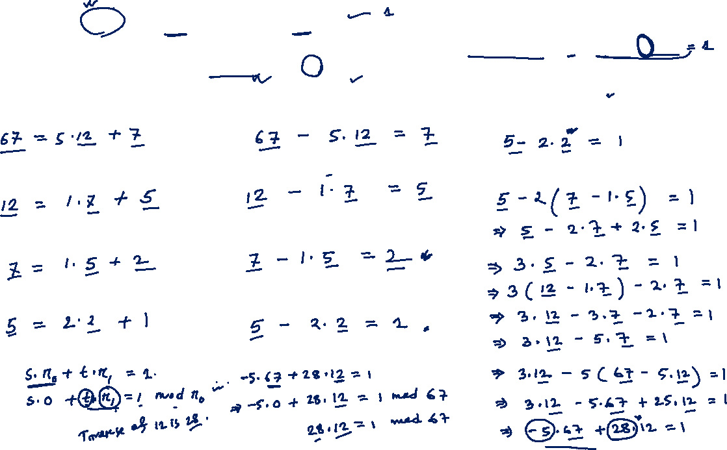
compute 12⁻¹ mod 67. The values 12 and 67 are relatively prime, i.e., gcd(67,12) = 1. If we apply the EEA, we obtain the coefficients s and t in gcd(67,12) = 1 = s·67+t ·12. starting with the values r0 = 67 and r1 = 12,
Euclidian | Rewrite | Euclid Solution

Slide 32
Example 6.7. Compute the inverse of A(x) = x² in the finite field GF(2³) with P(x) = x³ + x + 1
Euclidian Algorithm | Rewrite | Euclid Solution

Slide 33
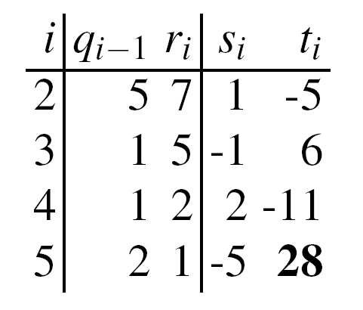

Extended Euclidean Algorithm 2/2
Example:
Calculate the modular Inverse of 12 mod 67:
From magic table follows
Hence 28 is the inverse of 12 mod 67.
Check:
For the full Extended Euclidean Algorithm see Chapter 6 in Understanding Cryptography.
✓

Slide 34
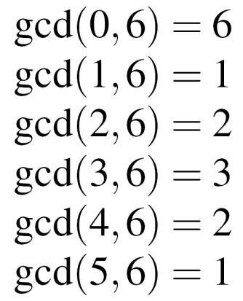
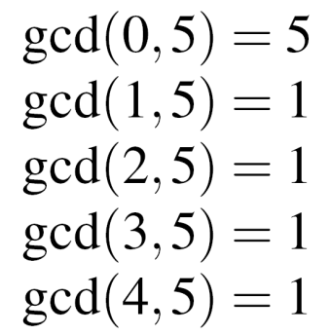
Euler‘s Phi Function 1/2
New problem, important for public-key systems, e.g., RSA: Given the set of the m integers {0, 1, 2, …, m -1}, How many numbers in the set are relatively prime to m ?
Answer: Euler‘s Phi function Φ(m)
Example for the sets {0,1,2,3,4,5} (m=6), and {0,1,2,3,4} (m=5)
→ 1 and 5 relatively prime to m=6, → Φ(5) = 4 hence Φ(6) = 2
Testing one gcd per number in the set is extremely slow for large m.

Slide 35
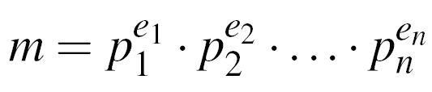
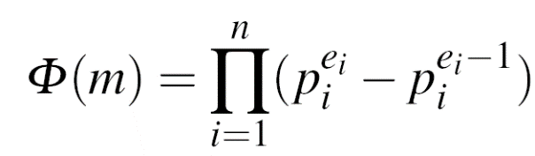
Euler‘s Phi Function 2/2
If canonical factorization of m known: (where p_{i} primes and e_{i} positive integers)
then calculate Phi according to the relation
Phi especially easy for e_{i} = 1, e.g., m = p . q → Φ(m) = (p-1) . (q-1)
Example m = 899 = 29 . 31: Φ(899) = (29-1) . (31-1) = 28 . 30 = 840
Note: Finding Φ(m) is computationally easy if factorization of m is known (otherwise the calculation of Φ(m) becomes computationally infeasible for large numbers)

Slide 36
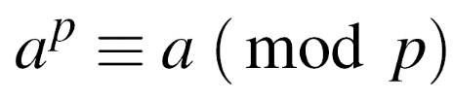
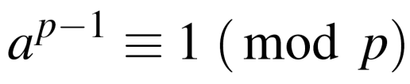

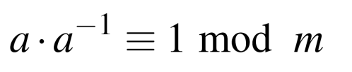
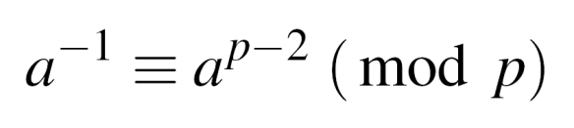


Fermat‘s Little Theorem
Given a prime p and an integer a:
Can be rewritten as
Use: Find modular inverse, if p is prime. Rewrite to
Comparing with definition of the modular inverse
→ is the modular inverse modulo a prime p
Example: a = 2, p = 7
Fermat‘s Little Theorem works only modulo a prime p
✓

Slide 37
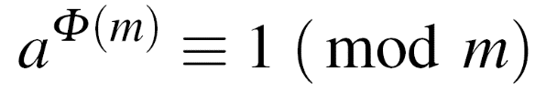

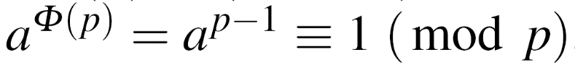
Euler‘s Theorem
Generalization of Fermat‘s little theorem to any integer modulus
Given two relatively prime integers a and m :
Example: m=12, a=5
1. Calculate Euler‘s Phi Function
2. Verify Euler‘s Theorem
Fermat‘s little theorem = special case of Euler‘s Theorem
for a prime p:
→ Fermat:

